Slide 1

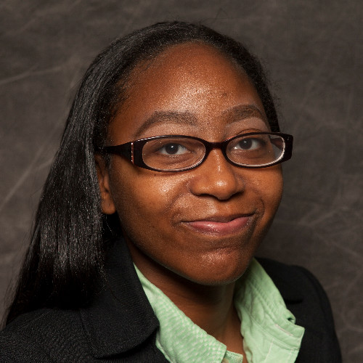

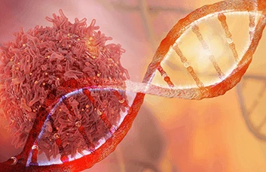
Our Team for Pysickle Cell
A tool for medical practitioners to diagnose Sickle Cell Disease (SCD)
early.
Brandii Baugh
Poornima Shahitha Katragadda
Coder
Coder
The original coder is: EHLeRoux from https://github.com/EHLeRoux/SickelCellDisease
Our code: https://github.com/ksu-hmi/PySickleCell

